Slide 1

Veg Hunters Assembly - Instructions
This is a school assembly which can be used in class or for the whole school
This assembly introduces the children to the programme in your school.
You can modify it to suit how you are going to use the programme in your school.
Slides 2-6 introduces the children to this year's theme.
Slide 7 – introduces the idea of Veg Hunter Champions if you are not going to select or appoint pupils to be Veg Hunter Champions, please remove this slide. If you are then this would be a great point to explain how you are going to run this in your school.
Slide 8-9 – tells the children about the Great Veg Vote. If you are not going to run this element, please remove these slides. If you are running the vote, you can explain how it will work in your school.
Slide 10 – explains the decorations if you plan to decorate your lunch area, classroom or communal areas. This also includes the Schools Challenge; you could explain what your school is going to do to enter. If you are not planning to enter you could remove this image.
Slides 11-12 – shows the children the participation stickers they can get for trying veg at lunchtime, with more cautious children just a sniff or lick might need to do (no pressure) and the take-home packs the children so enjoy
NB: This version does not include the video, please go to the website to find the version with videos
For more information on all these elements of the programme and the full Programme Guide go to https://eatthemtodefeatthem.com/schools/

Slide 2


Slide 3


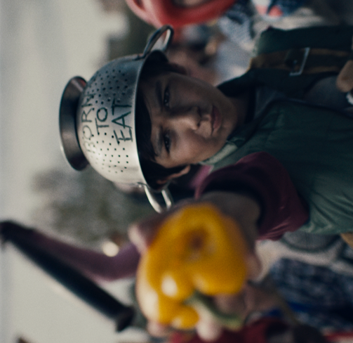

You are now part of an ever increasing ‘alliance’ of over 1 million children across the UK who are on a mission to defeat the veg.
1
million

Slide 4



Are you ready to become a Veg Hunter?
To find the veg wherever they are hiding?

Slide 5






Look out for these veg
What do we do when we find them?

Slide 6
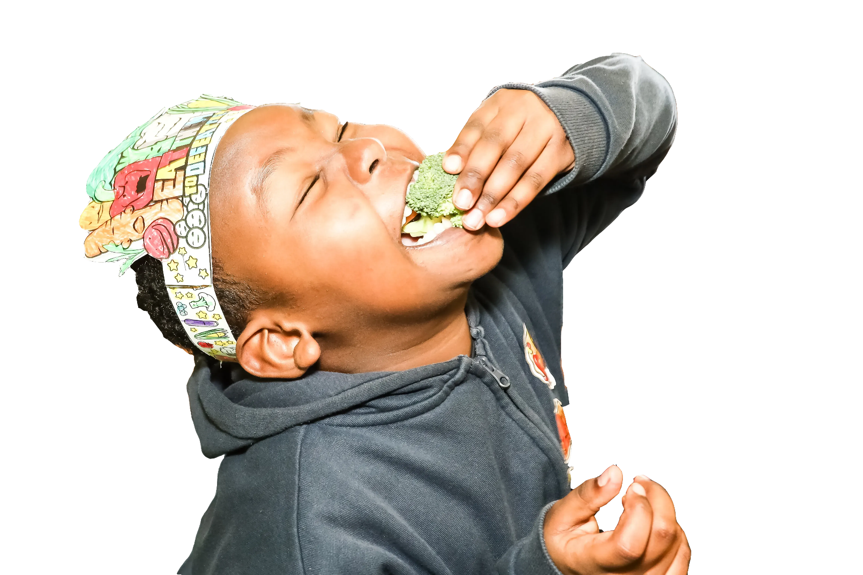

Slide 7






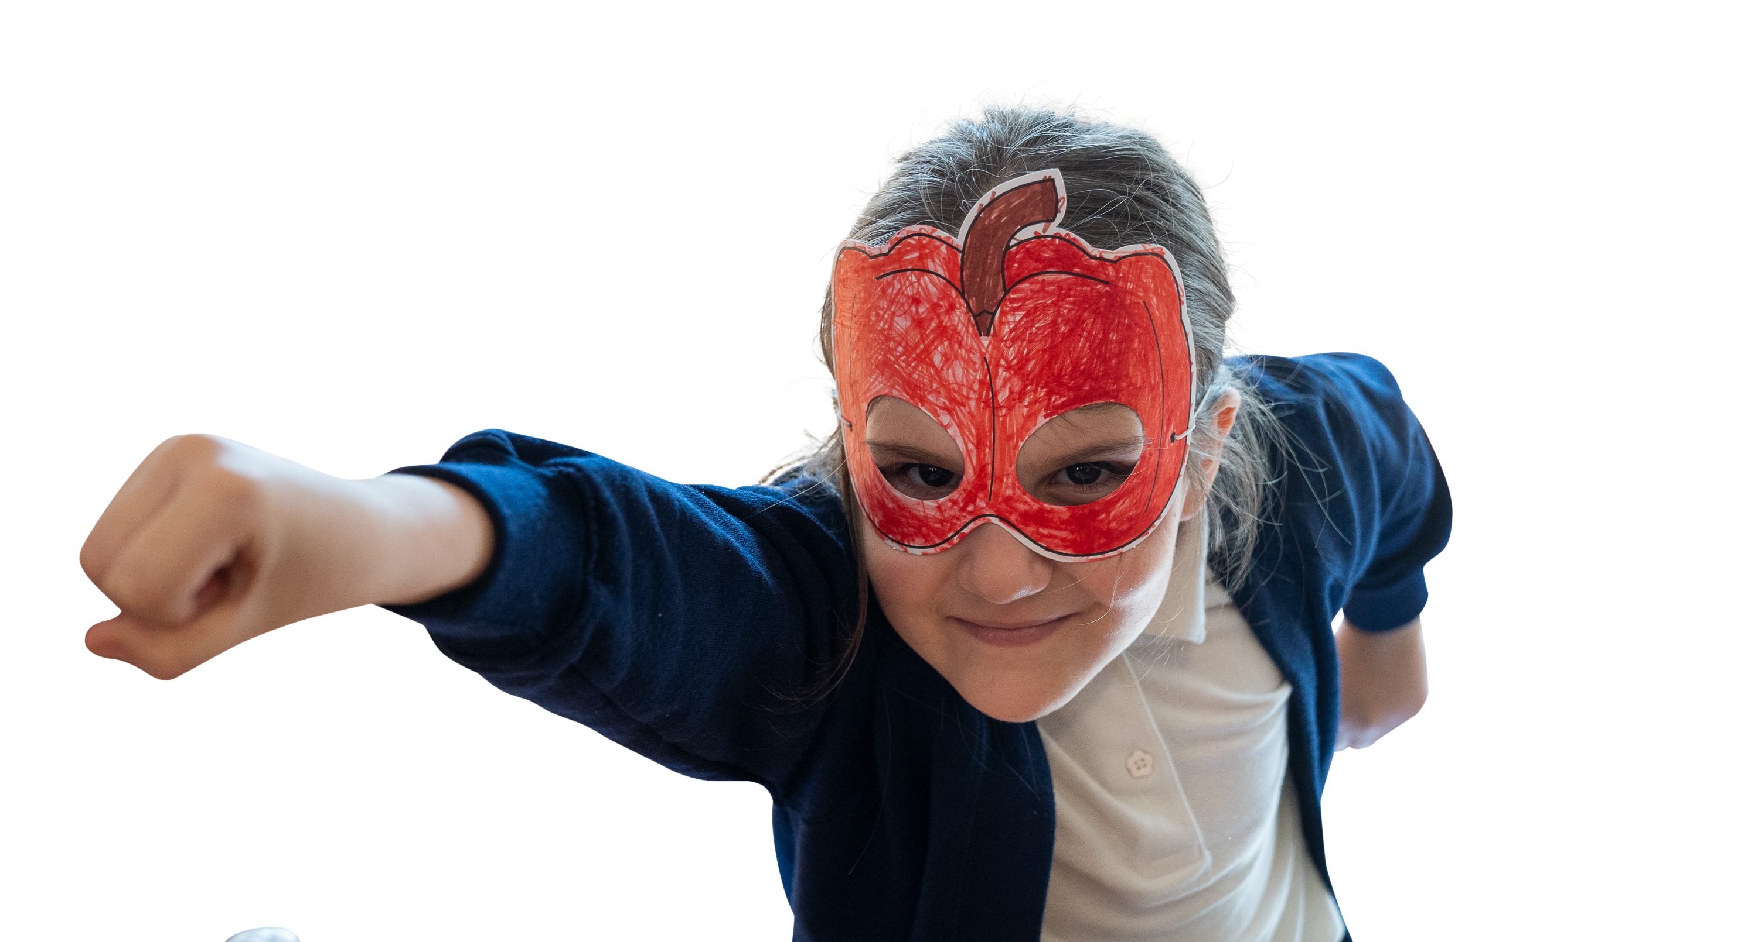
Leading our mission to defeat the veg

Slide 8

What veg do you eat and defeat?

Slide 9


We can show our school’s choice on this huge wallchart
Plus add our votes to the massive nationwide poll

Slide 10
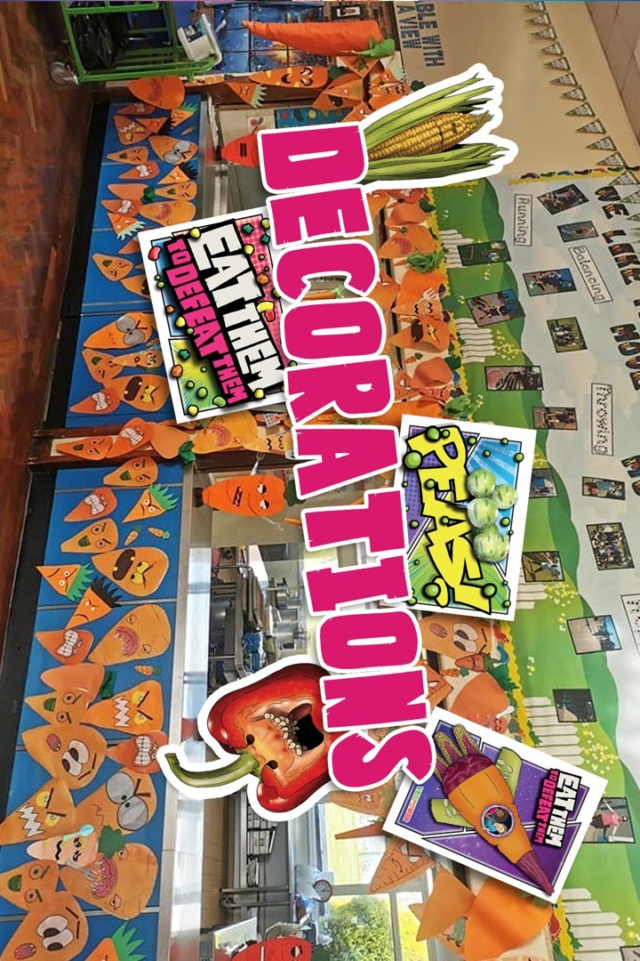


Slide 11





Lunchtime
Stickers

Slide 12

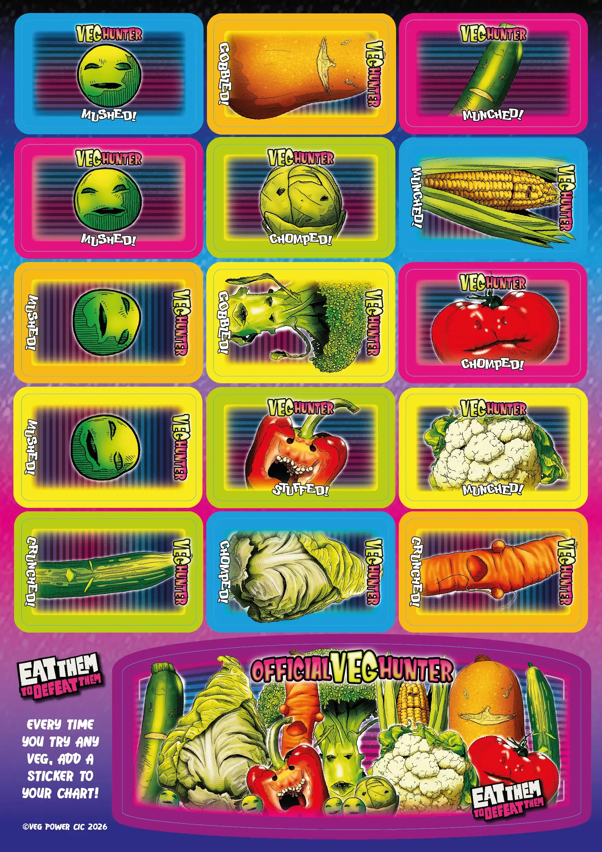
Mission Packs and sticker sheets for everyone to take home.
Can you find the veg at home and…

