Slide 1


Great Veg Vote - Instructions
This presentation supports the Great Veg Vote lesson plans which are available here:
https://eatthemtodefeatthem.com/schools/the-great-veg-vote/
Slides 2 introduce children to the vote explaining that it is part of a massive national poll of children, we want to find out which vegetable they like and eat regularly and which ones they should try.
Slide 3-7 – introduces each of the vegetables and can be used differently depending on how you have decided to run the vote in your schools and class - please see the vote lesson plans for more details.
Slide 8 – if you decide to use the voting cards which allow each child to cast their votes this slide is for you. If you are using a different approach, you might remove this slide.
Slide 9 – explains the jumbo wall A1 wall chart we are going to send you just before half term where you can map the whole schools votes in once place, you can also download a small mono version from the website to use at class level.
For more information on all these elements of the programme and the full Porgramme Guide go to https://eatthemtodefeatthem.com/schools/

Slide 2

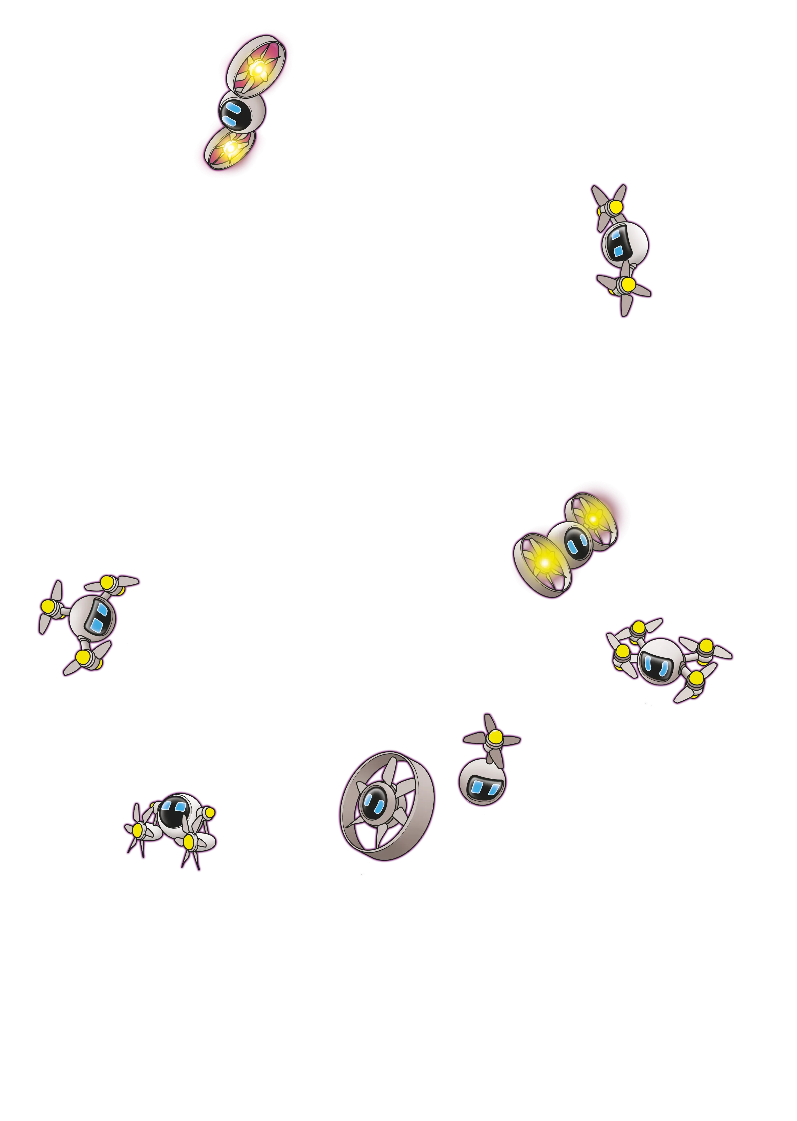
What veg do you eat and defeat?

Slide 3


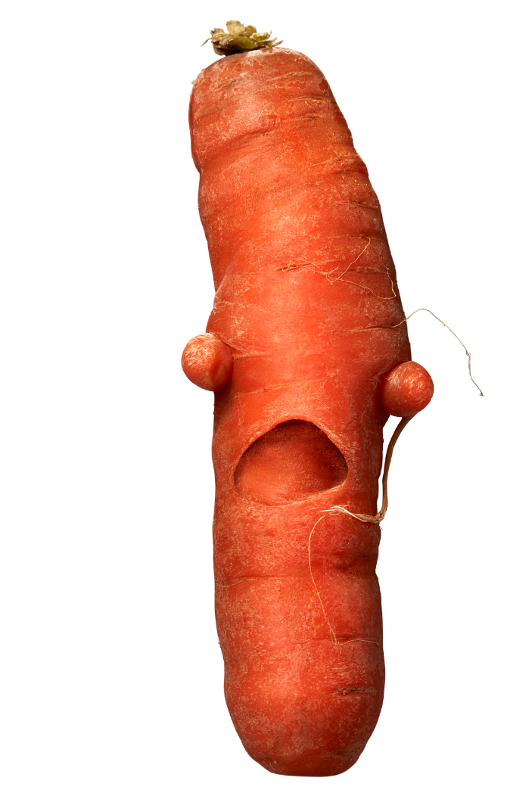
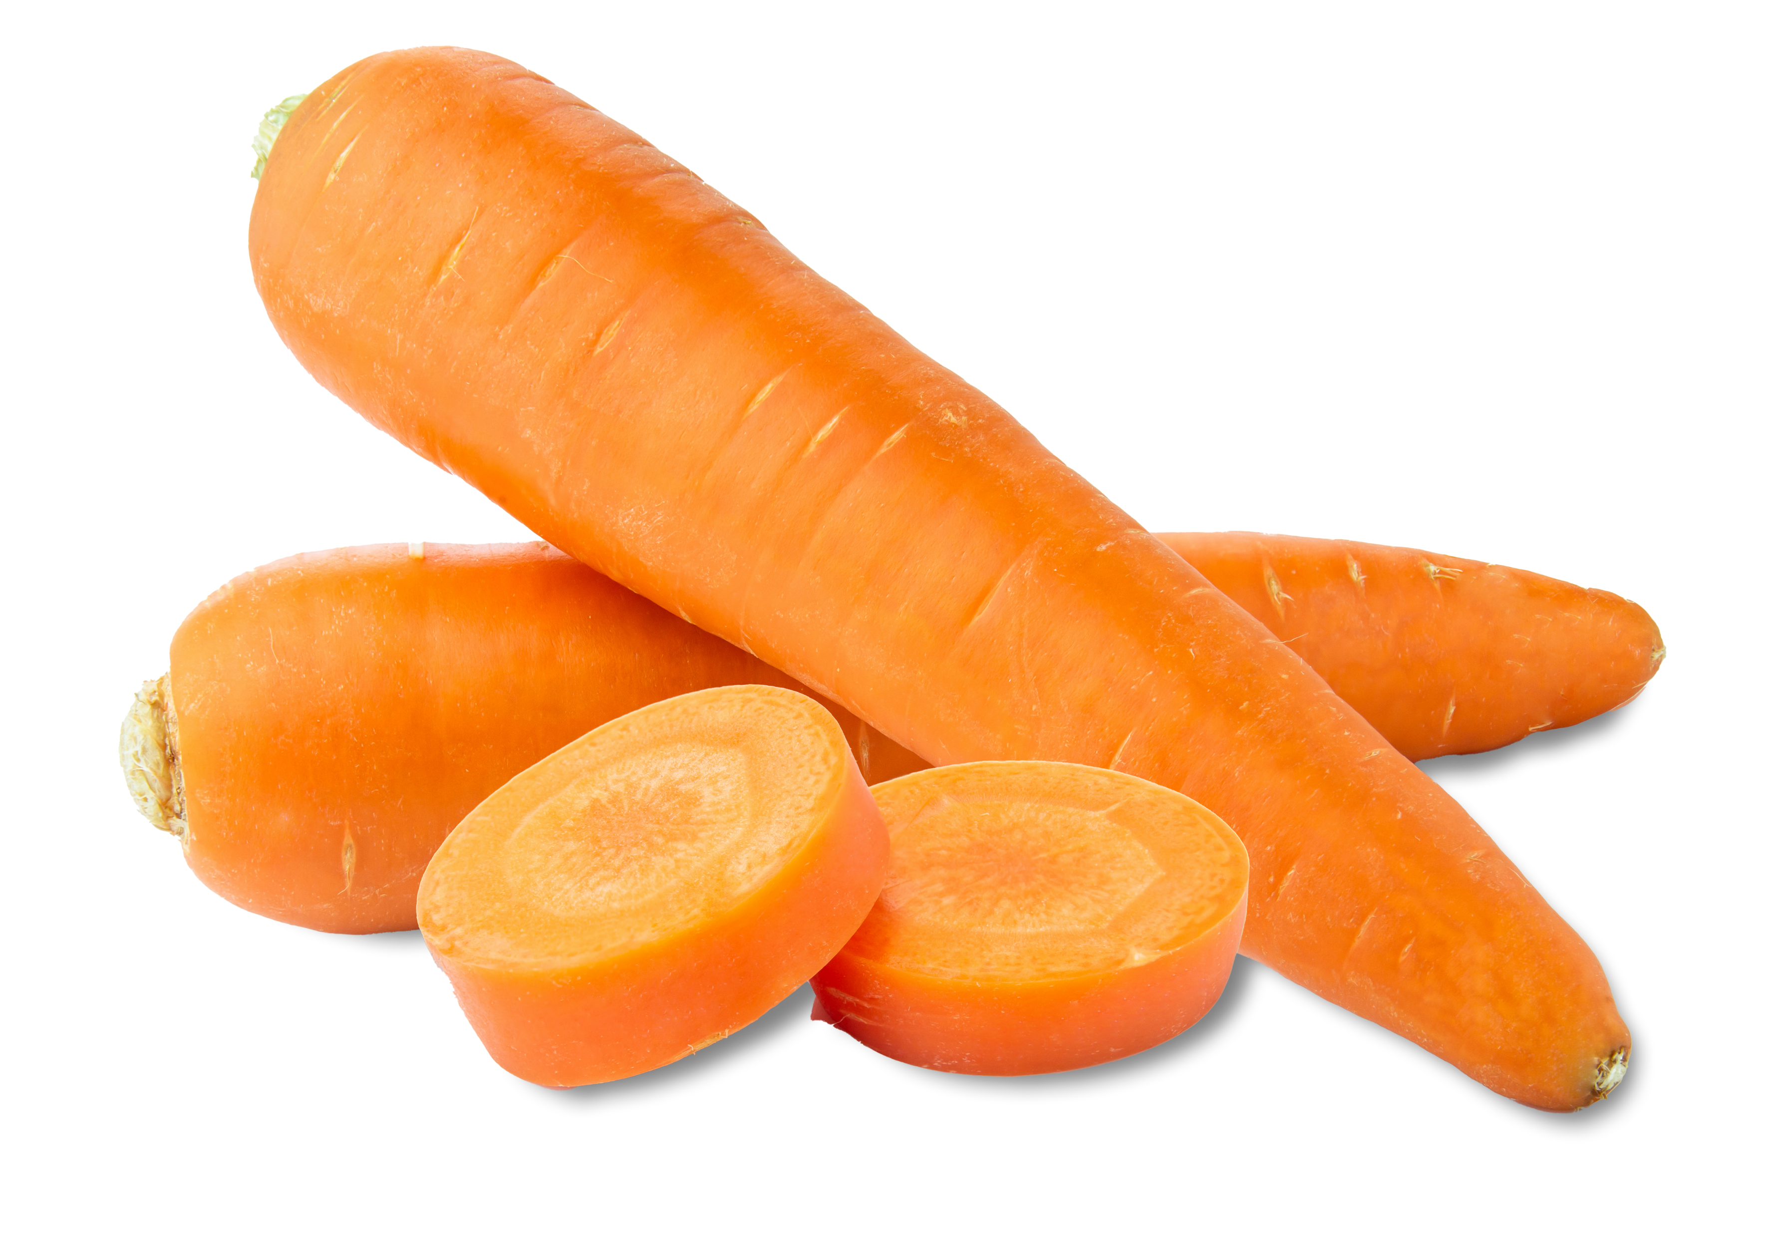

What is this
vegetable?

Slide 4


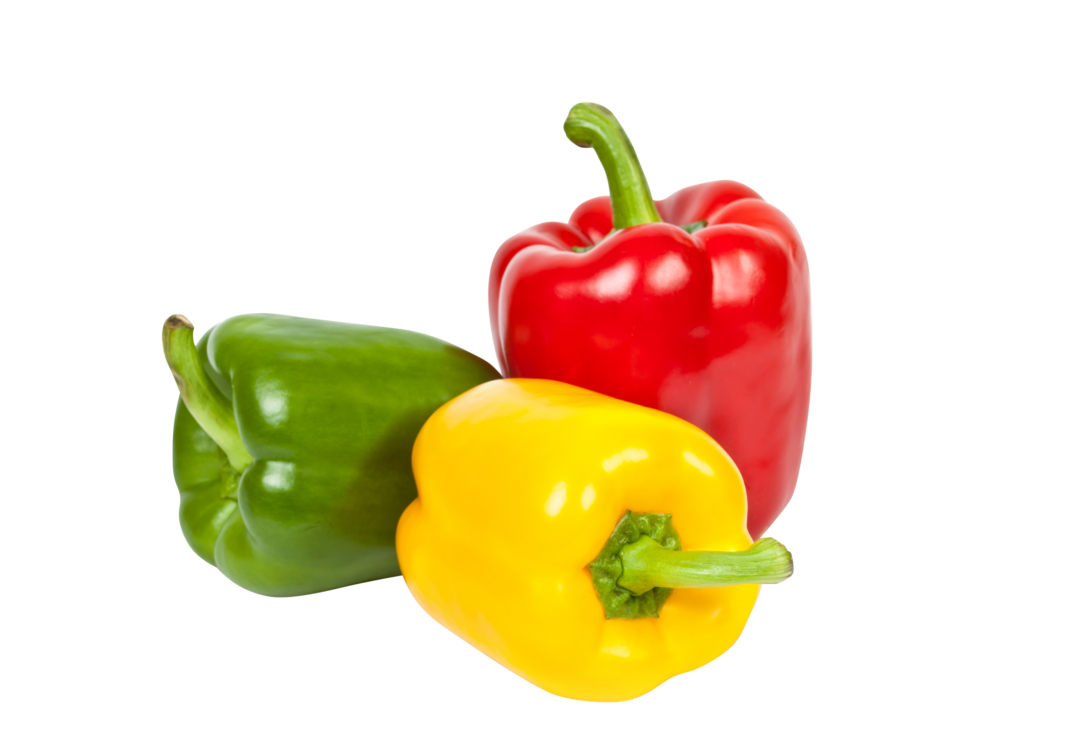
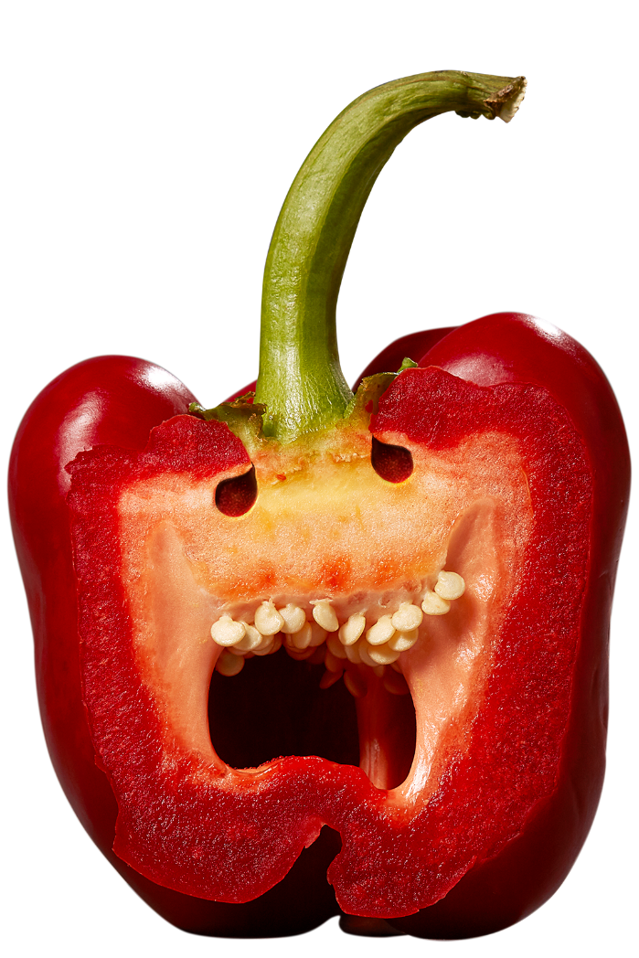

What is this
vegetable?

Slide 5
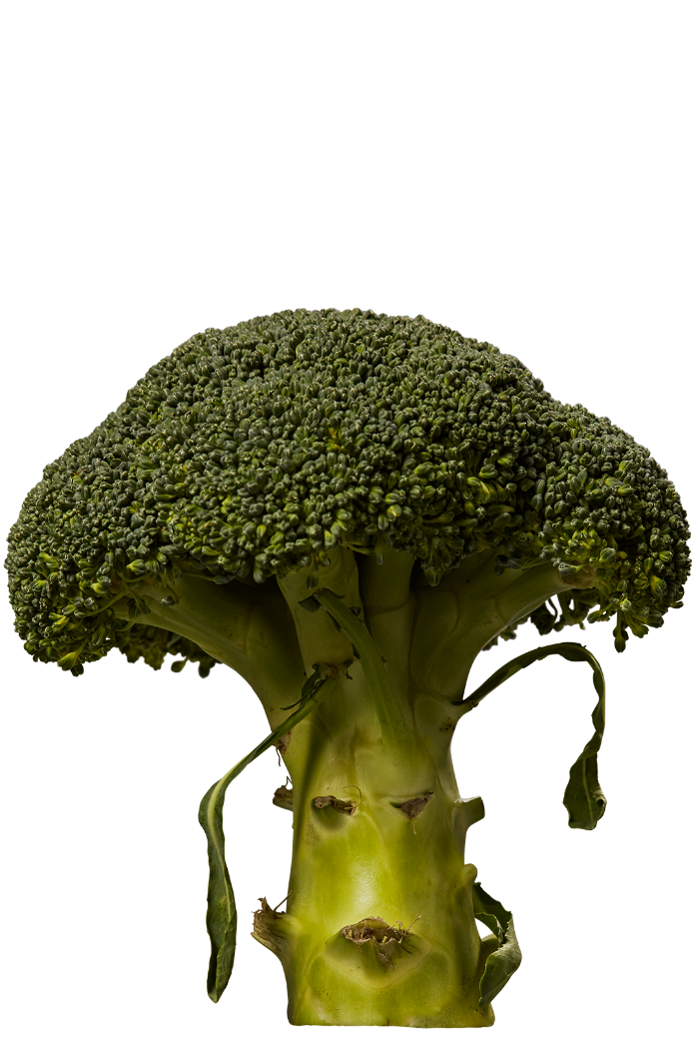

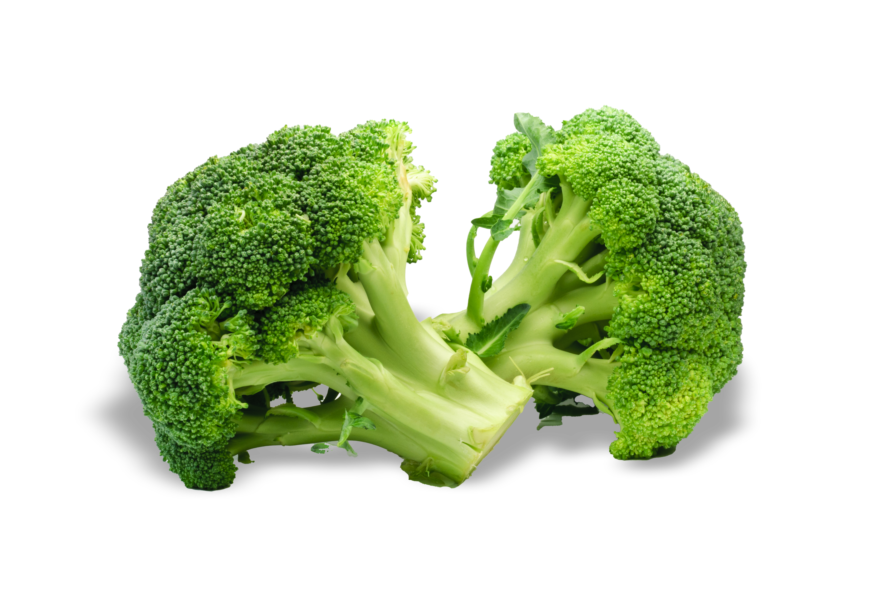

What is this
vegetable?

Slide 6

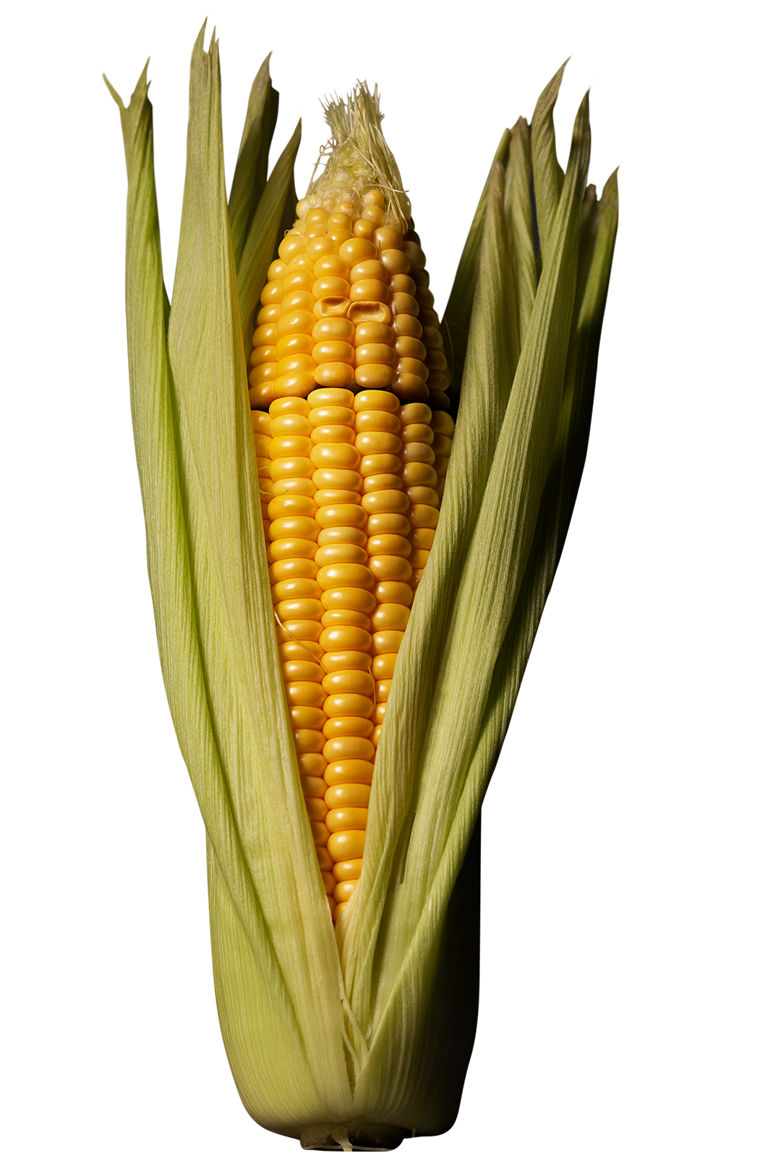

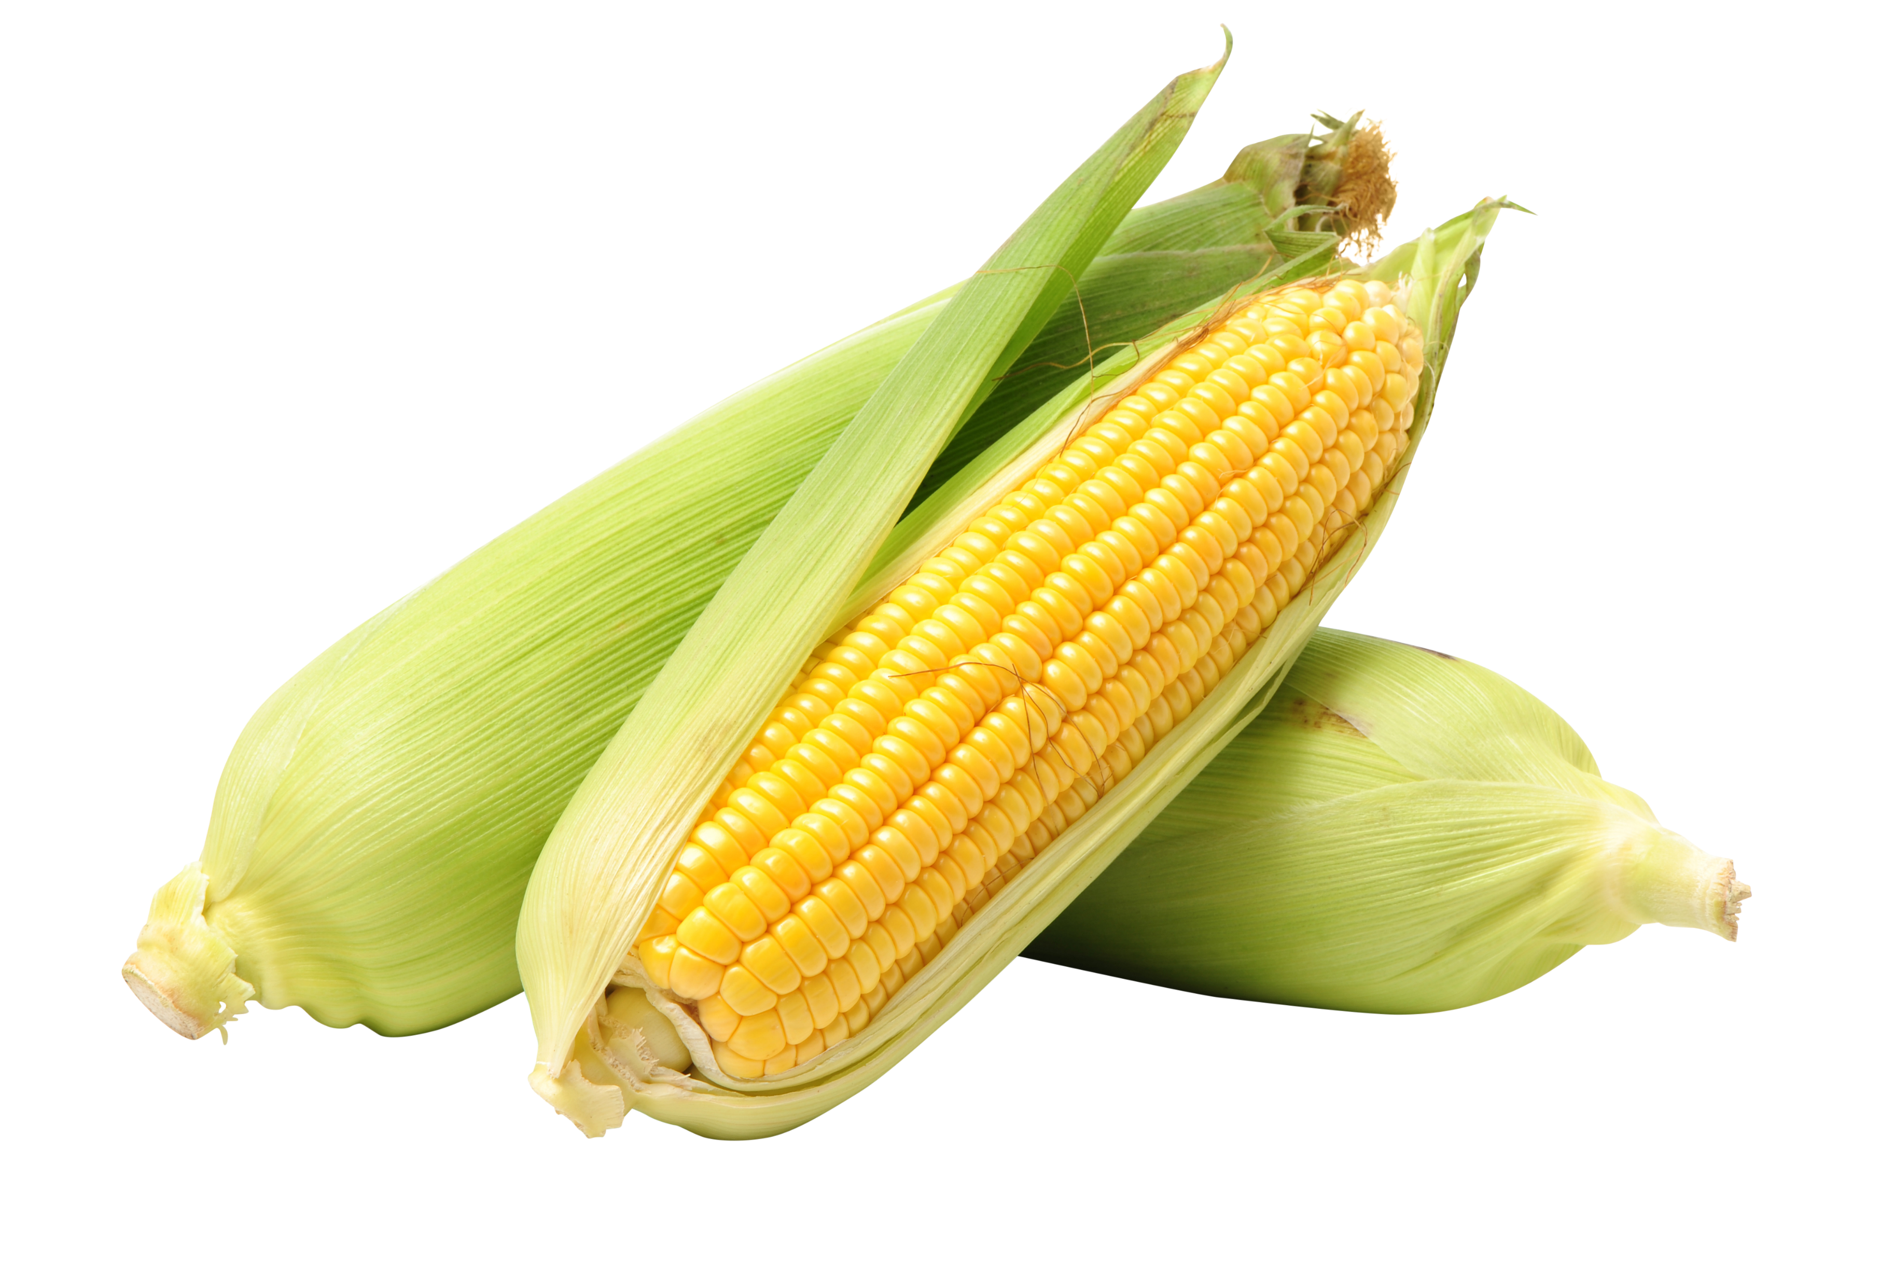

What is this
vegetable?

Slide 7


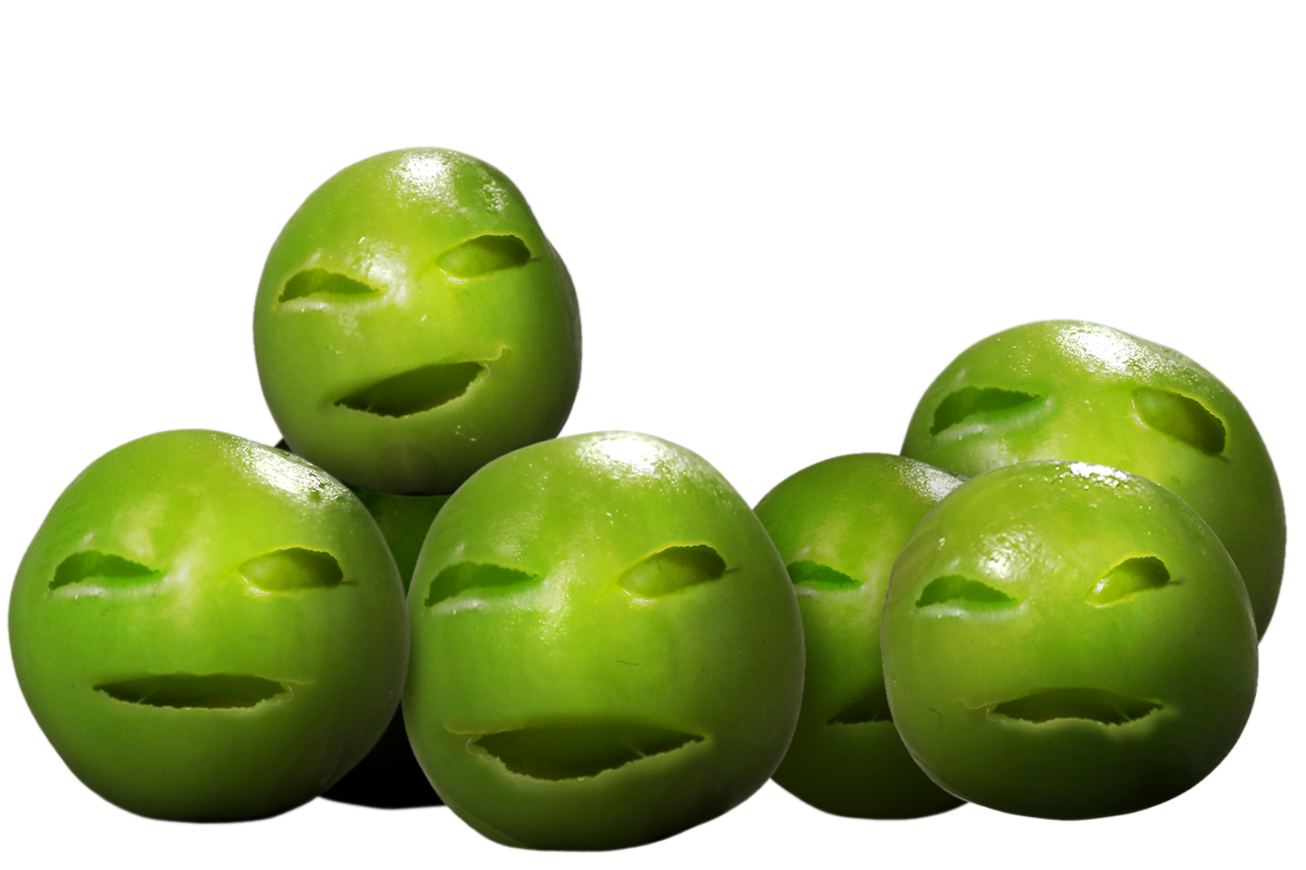

What is this
vegetable?

Slide 8

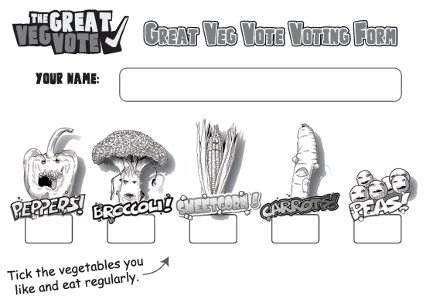

Tick all the vegetable you like and eat regularly

Slide 9
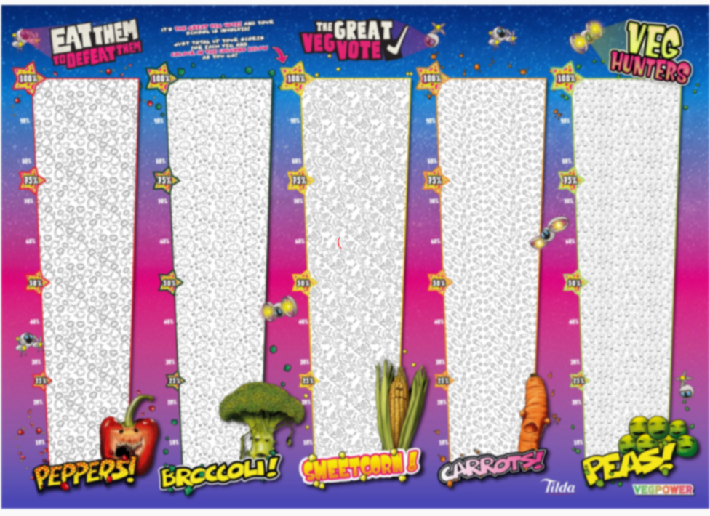
We can show our school’s choice on this huge wallchart
Plus add our votes to the massive nationwide poll

